Slide 1
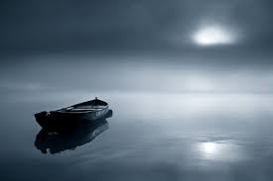
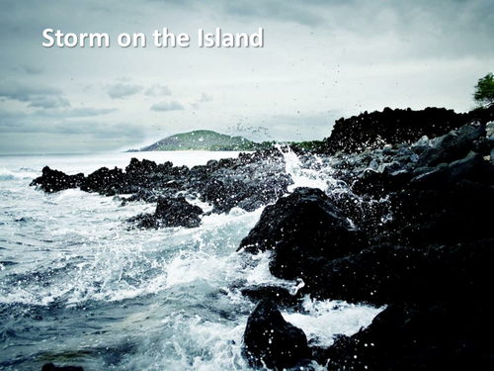
Starter: Remind yourself of The Prelude and Storm on the Island

Slide 2

Assessment Objectives
AO1: Read, understand and respond to texts. Students should be able to: maintain a critical style and develop an informed person response; use textual references, including quotations, to support and illustrate interpretations.
AO2: Analyse the language, form and structure used by a writer to create meanings and effects, using relevant subject terminology where appropriate.
AO3: Show understanding of the relationships between texts and the contexts in which they were written.
AO4: Use a range of vocabulary and sentence structures for clarity, purpose and effect, with accurate spelling and punctuation.
Notes:
Resource 1. Additional help for this task can be found on p. 6 & 7 in the poetry student book.

Slide 3
Date: 1805
Power and conflict
Title: The Prelude
Poet: William Wordsworth
Main Idea/ Theme:
The power of nature to change man
Language/ Form:
Blank verse
Personification
Enjambment
Caesura
Similes
Repetition
Sibilance
Imagery:
Personification of nature and the mountain.
Context:
Wordsworth reflecting on his childhood experience of stealing a boat and rowing out on a lake
Tone: Moves from excited and mischievous to scared before ending feeling depressed
Rhythm/ Rhyme:
Blank verse (unrhymed IP)

Slide 4
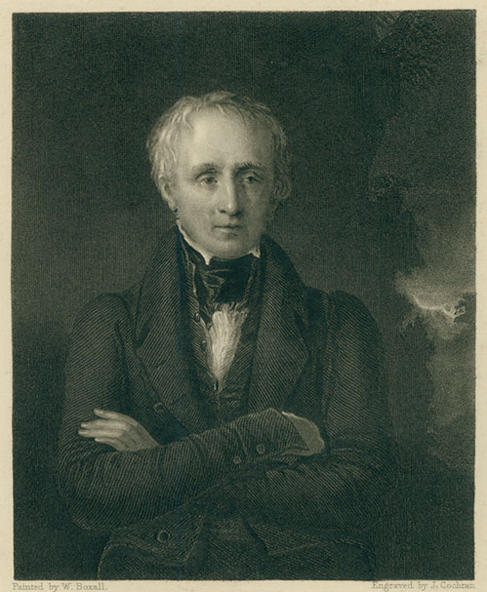
William Wordsworth
AO3 Text-Context Link
Wordsworth was the stereotypical Romantic poet. He spent most of his life composing poetry as he walked around the Lake District. His poems are all about trying to restore the relationship between man and nature.
He was made Poet Laureate in 1843.

Slide 5
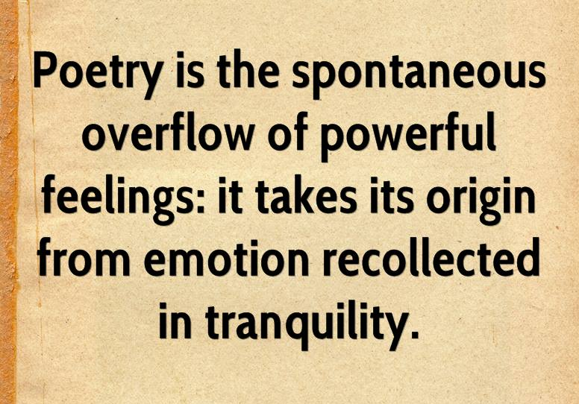
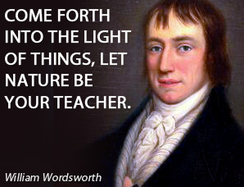
William Wordsworth
AO3 Text-Context Link

Slide 6
Romanticism
AO3 Text-Context Link
Romanticism was a school of thinking which believed in restoring the balance between man and nature. They believed that emotion was a key element to poetry.
The power and serenity of nature were important elements to the early romantic poets.
They believed that the people who lived in the country, particularly children, had the best appreciation for nature. Many of them wrote about the social injustice of the condition of the common people.
Three key ideas: revolution, nature and transcendence

Slide 7
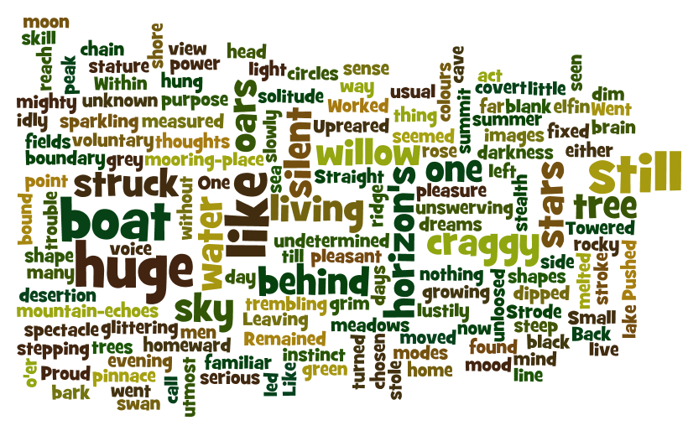

Slide 8
Poetry word of the week: Numinous
Numinous (adjective)
If something is numinous it ‘arouses spiritual or religious emotion’ or is ‘mysterious or awe-inspiring.’
Can you incorporate this into your response?

Slide 9
Date: 1966
Power and conflict
Title: Storm on the Island
Poet: Seamus Heaney
Main Idea/ Theme:
Power of nature and the resilience of man under siege
Language/ Form:
Sibilance
Personification
Similes
Oxymoron
Consonance
Enjambment
Military imagery
Anticlimax
Imagery:
Nature is personified in an aggressive way and appears to be the enemy (military imagery)
Context:
Set on an isolated island which is caught in a violent storm.
Tone: resigned and conversational
Rhythm/ Rhyme:
Blank verse

Slide 10
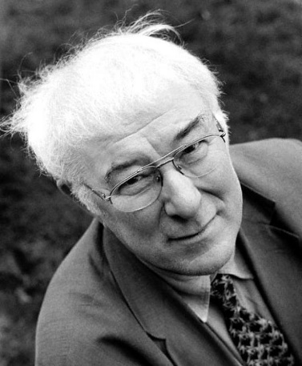
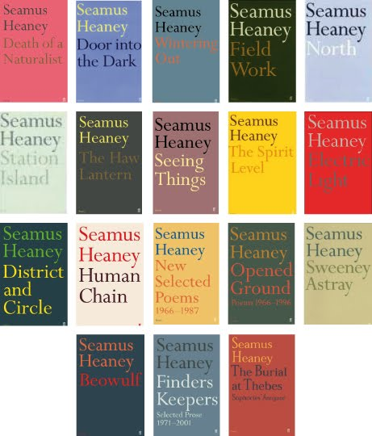
Seamus Heaney
Irish poet who was born on a farm in County Derry and began publishing poetry in the 1960s.
In 1995 he won the Nobel prize for literature.
In 2008 he was responsible for two thirds of all poetry sold in the U.K.

Slide 11
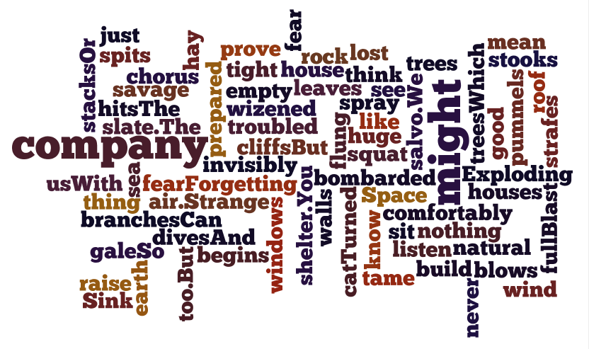

Slide 12
Let’s talk about Seamus
Savagely sibilant simile
Explosive enjambment
Aggressive anti-climax?
Military images
Untroubled by plants
Search for company

Slide 13
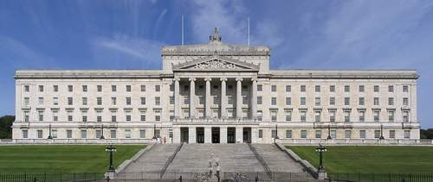
The title could contain a hint at another meaning.
There is no determiner in front of the title so the first 8 letters spell the word ‘Stormont’. This is the name of the official government building in Belfast.
This may indicate a link to the Irish ‘Troubles’

Slide 14
Comparing the poems
Feature/ technique | The Prelude William Wordsworth | Storm on the Island Seamus Heaney
The power of nature | Nature is personified in an attractive way (“led by her”) as well as a terrifying way (“a huge peak, black and huge”). | Nature is personified as an enemy who must be prepared for (“we just sit tight”)
Nature can influence behaviour | Nature can alter the thinking/ moral code of a person (“My brain worked with a dim and undetermined sense of unknown modes of being”) | Their houses are built with the storms in mind (“we built our houses squat”)

